Slide 1
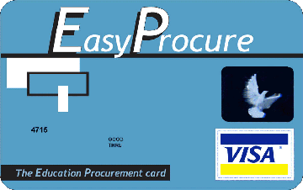
EasyProcure
The Education Procurement Card
Informational Webcast for Interested Schools in Ohio and Pennsylvania
Wednesday, May 14,2014 1:30 p.m.
The audio portion of this event will stream through your computer, please ensure your volume is on and at a desirable level.
Audio for this event will stream through your computer. If you are unable to connect to audio through the computer, you can dial-in over a traditional telephone line:
Dial-In: 866-579-8110
Passcode: 1937825

Slide 2
Today’s Presenters
Jay Himes, EasyProcure & PASBO
Scott Fratturelli and Kurt Hanna, PNC Treasury Management
Brian Wilson, Hilliard City SD (OH)
Christine Hakes, PRSBA, Camp Hill SD (PA)
An Tran, PNC Public Finance Group

Slide 3
Objectives of Today’s Discussion
Introduce EasyProcure, a joint venture between PASBO, PSBA, PASA, PSDLAF, OASBO, OSBA and BASA
Provide insight into procurement cards and the fast changing commercial payments landscape
Discuss economic benefits of integrating Purchasing Cards into the Procure-to-Pay Process
Share best practices associated with those entities that have effectively implemented a payment optimization strategy to generate measurable bottom line revenue and cost savings
Discuss how to join
Q&A

Slide 4







What is EasyProcure?
Joint Venture of:
Program created in PA in 2005 – Ohio joined in 2010
No fee PNC Bank Visa© purchasing card (Accepted anywhere Visa© commercial cards are accepted)
Rebates - The rebates are based upon program spend from June 1 to May 31 earning a rebate on the first dollar you spend!
  An aggregate total of participants’ purchases in both states during a 12 month period determines the level of rebate earnings
Notes:
4

Slide 5
What is EasyProcure?
PNC—State of PA procurement card provider
Rapid growth, rapid acceptance
More schools, more spend, more rebates to schools
PNC acquisition of National City Bank opened the door for the joint effort between PA and Ohio in 2010
Joined together for spend aggregation but independent state governance and policy.

Slide 6
EasyProcure-Program Growth

Slide 8
Combining Spend Increases Rebates for Both States and Their Participants
PA Program Spend (Not including large ticket items)
PA Program Spend (Large ticket items)
Basis Points on Regular Spend
Basis Points Earned Large Ticket
PA Royalties Earned
Ohio Program Spend (Not including large ticket items)
Ohio Program Spend (Large ticket items)
Basis Points Earned
Basis Points Earned Large Spend
Ohio Royalties Earned
Total Royalties - Earned Seperately
Total Combined Spend
Actual Rebate Earned
Difference Between Royalties Earned Seperately & Combined Royalty
PA's Portion of Total Spend
Ohio's Portion of Total Spend
PA's Portion of the Addl Royalty
Ohio's Portion of the Addl Royalty

Slide 9
EasyProcure Resources
www.easyprocure.org
  Auditor General Guidance
  Review by Counsel
  Sample Board Resolution (currently being revised)
  Merchant Category Code Groups (MCC Groups)
  Potential Areas for Card Usage
  Frequently Asked Questions’
  School Entities Currently Using EasyProcure Cards
  Implementation Guidelines
www.pasboerc.org (downloadable documents)
  Guidelines, procedures, user agreements, etc.
  Documents available Upon request
    PSBA Board Policy – Procurement Cards
    Visa© Purchasing Card Agreement and Resolution of Extension of Credit available upon request

Slide 10
Changing Payment Landscape

Slide 11
What is a Procurement Card?
A procurement card is similar to a credit card but with many internal controls. Its purpose is to streamline purchasing to reduce manual paperwork, which in turn will reduce administrative costs. It is considered a method of payment as well as a method of procurement.
Provides streamlined process to authorize, track, pay, and reconcile purchases
  Control at point of sale
  Automated posting to A/P or G/L
Eliminates manual paper based PO/Check process
Typically used for repetitive purchases and petty cash type items
  Employees deal directly with supplier via phone, fax, internet, or in person

Slide 12
What is a Procurement Card?
Provide increased control over purchases
Structured as corporate bill, payment, and liability
  Business office receives consolidated invoice for payment
  Cardholders receive memo statements for reconciliation

Slide 13
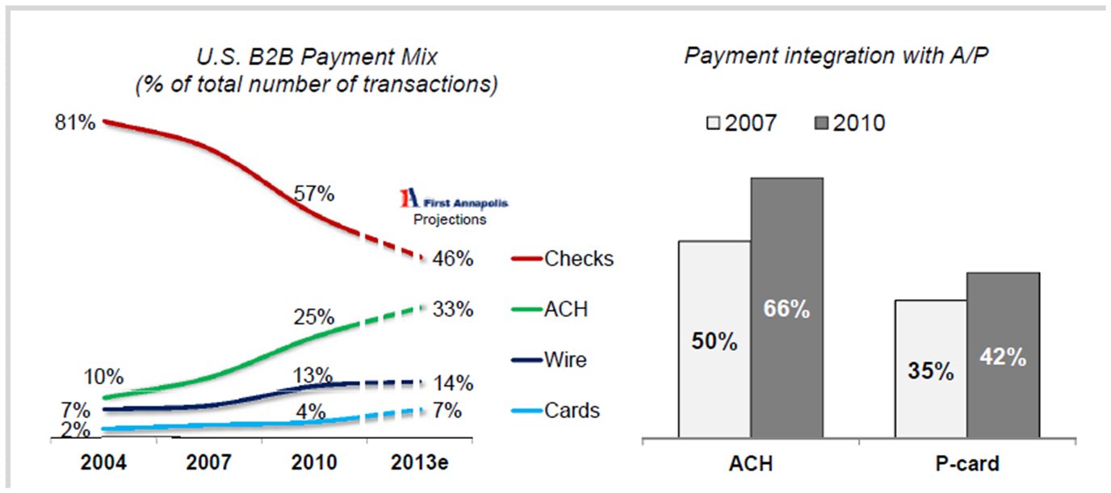
Payments Mix
Check displacement & payment integration with AP are powering electronic payments.
Source: AFP Electronic Payments Survey data for 2004-2010; .2011 First Annapolis Commercial Card Market Landscape

Slide 14
Benefits of Procurement Card Usage

Slide 15
Benefits of Card Usage
Why businesses and public organizations are moving purchase transactions onto commercial cards
Stronger control over fraud and misuse
  Limits individual employee spend
  Merchant category blocking
  Transaction size and spending limits
  Provides spending analysis reports grouping charges by industry/vendor based on merchant category codes
Increased productivity of employees
  Eliminates petty cash and purchase orders, streamlining inefficient purchasing paperwork
  Reduces use of personal cards, simplifying and accelerating employee reimbursement
  Timely access to information through web based reporting tools
Financial Benefits
  Card users gain an average of 15-20 days of extended float
  Cash rebates available when spending goals are achieved
  Check and mail costs and bank fees reduced
  Obtain vendor discounts for quicker payment

Slide 16
Benefits of Card Usage
Material differences in the economics of various payment alternatives create opportunities to pursue an optimum payment mix and a winning proposition.
 | Customer Average Cost Per Transaction*
Check | Incremental Expense: ($0.64) (bank fees and estimated mail remittance fees)
ACH | Incremental Expense: ($0.12)
Wire | Incremental Expense: ($7.00)
Commercial Card | Incremental Revenue Share: $3.75 (Estimated 75 basis points)
*Based on a $500 transaction
Notes:
16

Slide 17
Procurement Card Best Practices

Slide 18
Best Practices
Vendor Match
Process:
  Provide bank with a vendor file
  Bank will match the file against our extensive bank and VISA database to determine which of your current vendors are already accepting commercial cards
  Bank will provide you with a detailed analysis outlying all accepting vendors and potential return on investment
A Vendor Match Analysis is an effective tool for:
  Identifying target vendors for commercial card payments
  Determining spend and rebate potential
Notes:
18

Slide 19
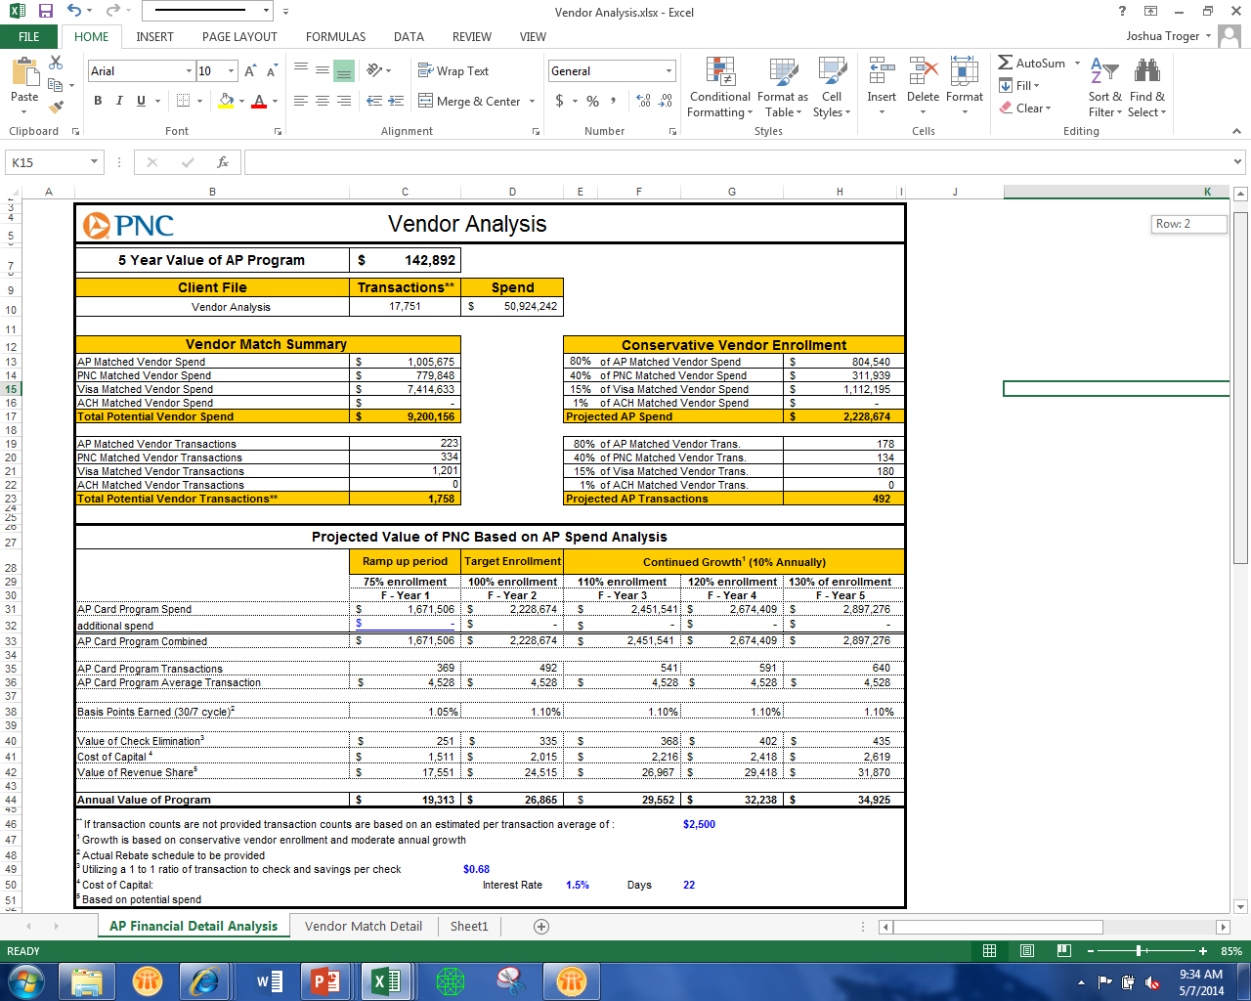
*Example for discussion only
Best Practices

Slide 20
Best Practices – Hilliard City Schools
Commonalities of High Performance Commercial Card Programs:
Establish realistic and achievable goals
Appropriate distribution and use of cards
Enforce policy/procedures, security management and spend controls; Sample policy and procedure guide
Establish communication & training activities
Timely reconcilement of accounts

Slide 21
Best Practices – Hilliard City Schools
Utilizing Online System:
Card Management
  Issue new cards
  Change limits and cancel cards in real time
  Update MCC restrictions
Utilize program technology & interfaces
  Automated Posting
  G/L
  Vendor File

Slide 22
Best Practices – Hilliard City Schools
Risky Areas to Monitor:
Use of cards at unauthorized vendors
Types of purchases (bid requirements)
Personal Use

Slide 23
Camp Hill School District
Small School Case Study

Slide 24
Camp Hill School District - Small School Case Study
About 25 active cards with varying limits:
  Superintendent
  Business Administrator
  Each Principal & building
  Food service operations
  Band program
  Home Economics program
  Four maintenance (gasoline)
  Technology
  Athletics
  Other (special programs, grants, drama)

Slide 25
Camp Hill School District - Small School Case Study
Use with most vendors for:
  Technology equipment
  Copiers, equipment contracts
  Gasoline
  Transportation services
  Repairs, maintenance contracts
  Instructional materials & supplies
  Office supplies

Slide 26
Camp Hill School District - small school case study
Eliminated purchase orders and utilized log (budget spreadsheet) for tracking cardholders budget.
Cardholder follows up with documentation (pkg slips; order form) and coding.
Monthly cardholder submits to business office. After clerical review (excel file created), Business Administrator authorizes the total District Pcard transfer.

Slide 27
Camp Hill School District - small school case study
Benefits:
Improved efficiencies – less: ”paperwork”, follow-up & time
    Quick turnaround of purchasing and accounts payable means materials are in the classroom sooner and full purchase information is known sooner.
Rebates
Customer satisfaction (faculty/staff and vendors)
Cautions:
Monitor activity – on-line and monthly statements
Clarify responsibility to cardholders (procedures & agreement)

Slide 28
Joining the Program
Step One:
  One Page application – accessible online
    Contact Information section
    Entity Information section, most important is
      #3 - Monthly credit limit requested for your program - must be provided
    Three years of audited annual financial reports
  Already a PNC procurement card user?
    Same one-page application as above
    Letter of authorization on school letterhead to transfer; no need for reports

Slide 29
Joining the Program
Step Two:
  After credit limit is approved by PNC, representative will make an appointment with you to complete:
    PNC Resolution for Extensions of Credit
    PNC Master Resolution and Signature Card for New PNC Account (if applicable)
Step Three:
  Card program setup process - PNC Implementation Team will contact program administrator directly

Slide 30

Q&A
At this time, we encourage you to participate in the Question and Answer portion of the webinar.

Slide 31
Thank You for Joining Us!
Scott Fratturelli
Vice President, Treasury Management
Telephone: 614-463-7332
Email: scott.fratturelli@pnc.com
Kurt Hanna
Vice President, Treasury Management
Telephone: 216-222-2628
Email: kurt.hanna@pnc.com
Laura Custer
EasyProcure OH Program Manager
Telephone: 614-463-7553
Email: laura.custer@pnc.com
Christine Hakes, PRSBA
Business Mgr./Board Secretary, Camp Hill SD
Telephone: 717-901-2400 Ext. 2412
Email: chakes@camphillsd.k12.pa.us
Brian Wilson
Treasurer, Hilliard City Schools
Telephone: 614-921-7000
Email: Brian_Wilson@hboe.org
An Tran
EasyProcure PA Program Manager
Telephone: 215-585-4978
Email: an.tran@pnc.com

Slide 32
Disclosure
The web seminar and/or materials were prepared for general information purposes only and are not intended as legal, tax, accounting or financial advice, or recommendations to buy or sell securities or currencies or to engage in any specific transactions, and do not purport to be comprehensive. Under no circumstances should any information contained in the web seminar, and/or materials be used or considered as an offer or a solicitation of an offer to participate in any particular transaction or strategy. Any reliance upon any such information is solely and exclusively at your own risk. Please consult your own counsel, accountant or other advisor regarding your specific situation. Any views expressed in the web seminar and/or materials are subject to change without notice due to market conditions and other factors.
PNC is a registered mark of The PNC Financial Services Group, Inc. (“PNC”). Bank deposit, treasury management and lending products and services, and investment and wealth management, and fiduciary services are provided by PNC Bank, National Association, a wholly-owned subsidiary of PNC and Member FDIC. Lending products and services, as well as certain other banking products and services, require credit approval. PNC does not provide legal, tax or accounting advice.
©2012 The PNC Financial Services Group, Inc. All rights reserved.

